Slide 1
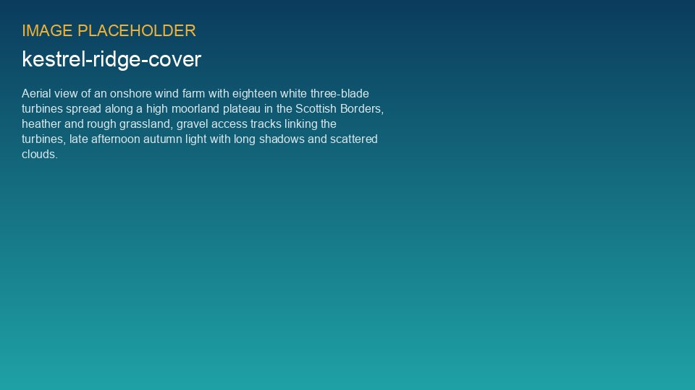
WEYLAND ENERGY
Kestrel Ridge – two years of operation
Lessons learned for the fleet and for Harrow Bay · Lunch & Learn, April 2026

Slide 2
The asset
75.6 MW
206.6 GWh
97.4 %
31.2 %
18 × 4.2 MW
Generation 2025
Availability 2025
Capacity factor 2025
WEYLAND ENERGY · Kestrel Ridge – Two Years of Operation
2

Slide 3
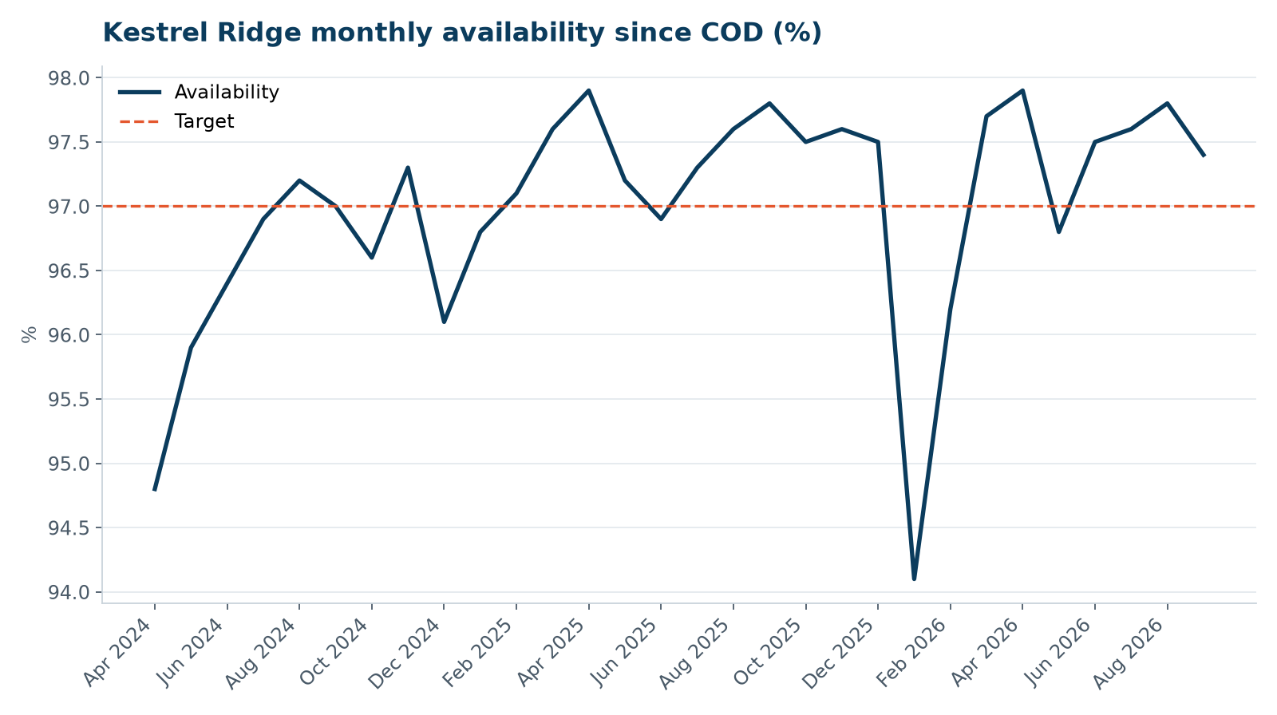
Availability since COD
• Teething issues in the first 3 months
• Stable above target through 2025
• January 2026: T-07 gearbox
WEYLAND ENERGY · Kestrel Ridge – Two Years of Operation
3

Slide 4
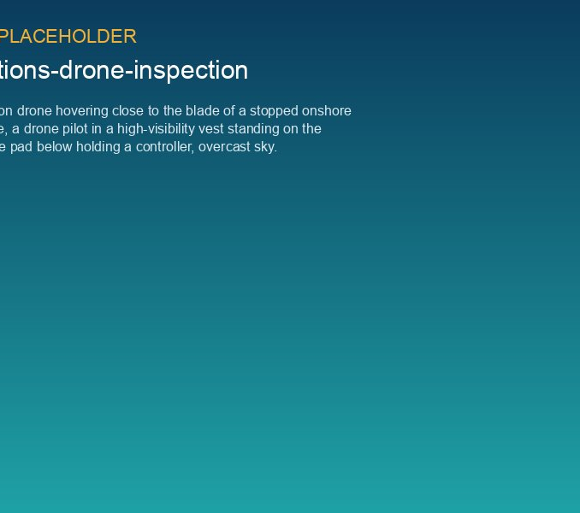
Lesson 1: own your condition data
• Generic CMS thresholds missed the T-07 bearing failure
• Retuned thresholds would have warned 6 weeks earlier
• Same method found T-12 early – saved a crane lift
WEYLAND ENERGY · Kestrel Ridge – Two Years of Operation
4

Slide 5
“The bearing told us in November. We just weren't listening.”
— Stuart Laidlaw, Highline Wind Services
WEYLAND ENERGY · Kestrel Ridge – Two Years of Operation
5

Slide 6
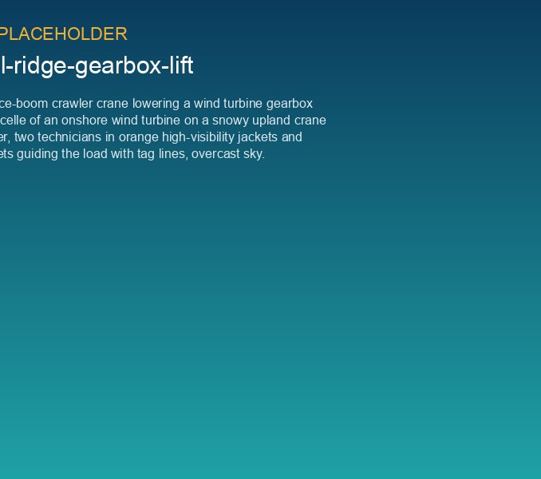
Lesson 3: plan the big lifts before you need them
• Crane framework and gearbox pool access
• Winter-proof crane pads and tracks
• Target: 18 days failure-to-power in winter
WEYLAND ENERGY · Kestrel Ridge – Two Years of Operation
6

Slide 7
Lesson 4: community details matter
• Shadow flicker modules must keep exact time
• Landowner relationships carried us through the T-07 lift
• Ice beacons on the public footpath – no incidents
WEYLAND ENERGY · Kestrel Ridge – Two Years of Operation
7

Slide 8
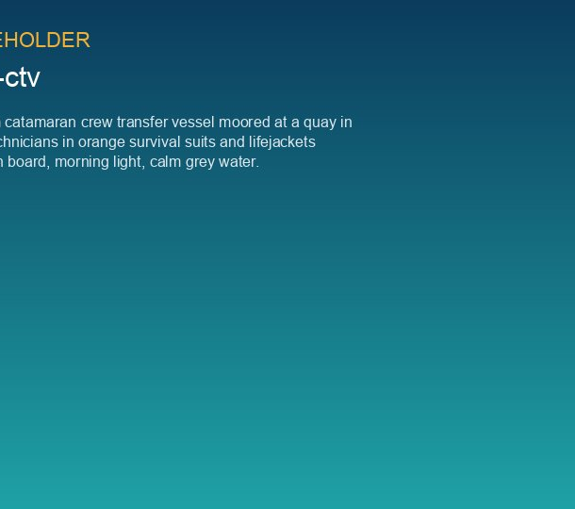
What this means for Harrow Bay
• Data access and CMS thresholds in the handover criteria
• Capital spares and pool agreements before COD
• Vessel and jack-up access plan for major components
WEYLAND ENERGY · Kestrel Ridge – Two Years of Operation
8
Notes:
Elena asked for this slide specifically – link to the O&M readiness plan.

Slide 9
WEYLAND ENERGY
Questions?
David Chen · Ben Okoye · Sara Lindgren

